Slide 1
Matlab plot data selection for training

Slide 2
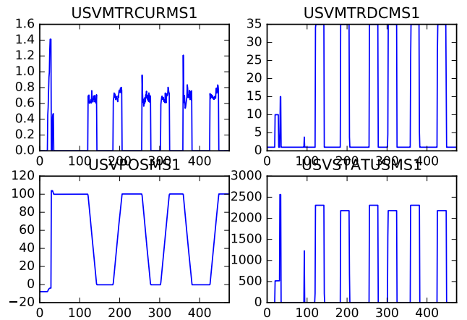
Plot from Python

Slide 3
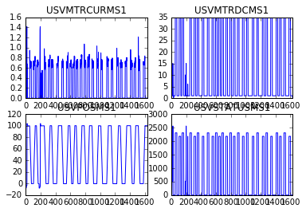

Slide 4
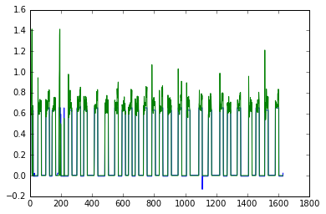
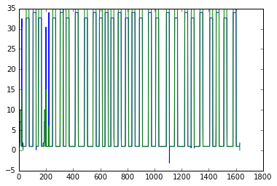
Use status word as input, to predict the other three, Python result
current
Duty cycle

Slide 5
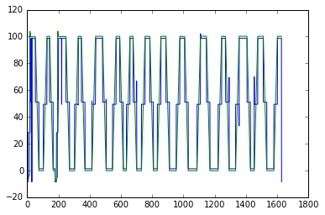
Valve position match well

